Slide 1
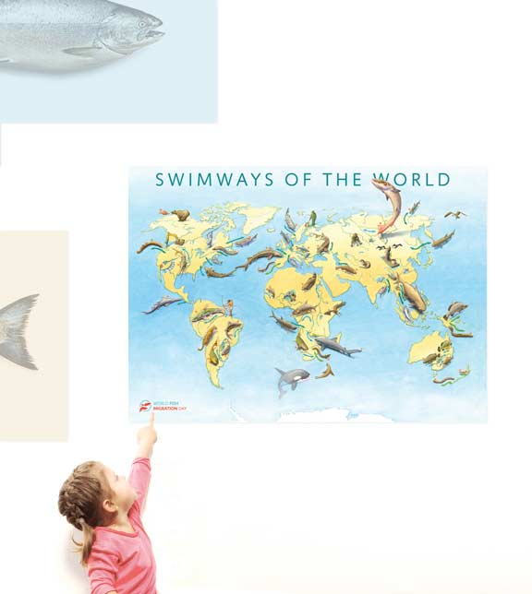

Slide 2
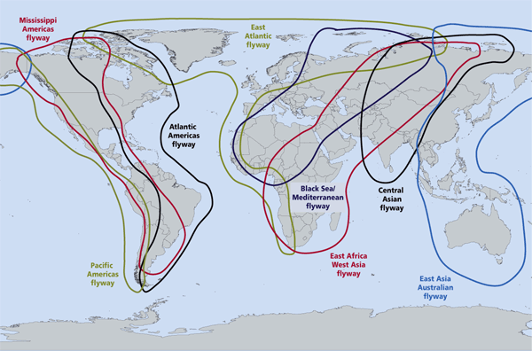
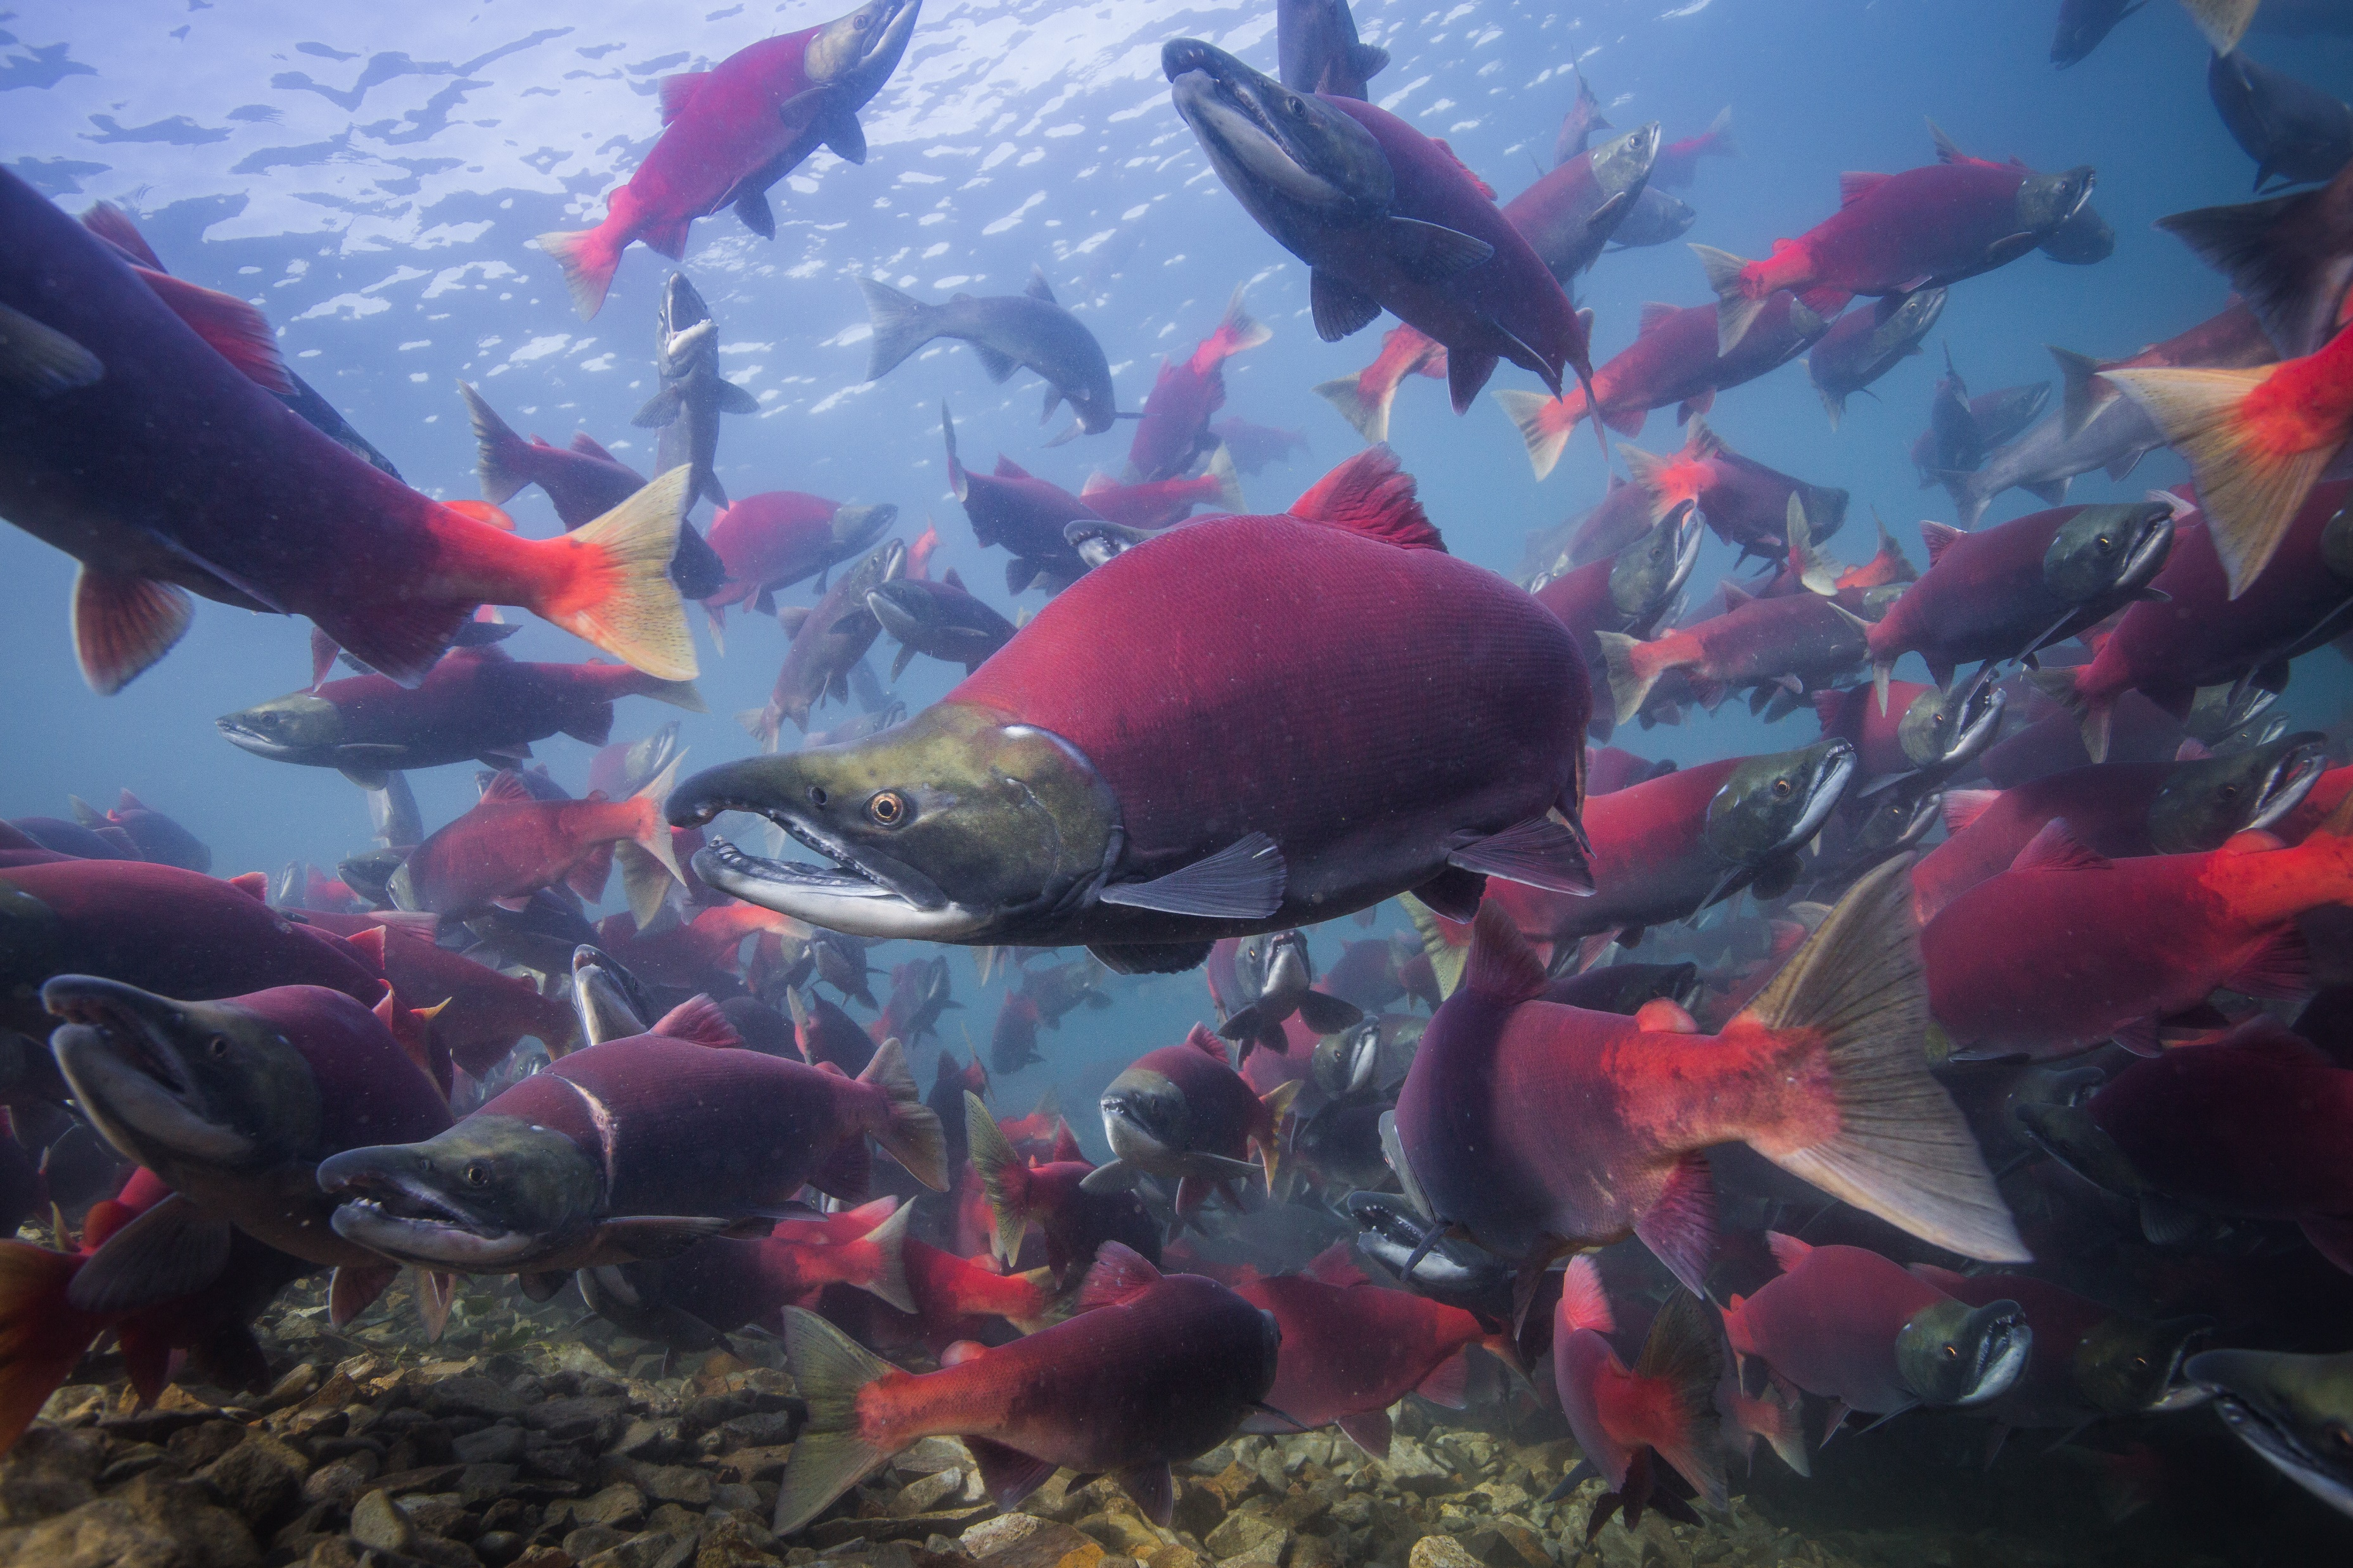

Slide 3
WWF/ZSL, still unpublished, based on 981 populations of 180 species, potamodromous, anadromous, catadromous or amphidromous
Notes:
Many migratory fish species are severly threatened. The main causes are man-made obstacles like dams, weirs and sluices, which disrupt the natural flow of rivers and prevent fish migration. Many fish need to migrate to reproduce, feed and complete their life cycles. Migratory fish make up a crucial link in the food chain and plays an important role in healthy and productive river systems. Furthermore they provide an important food supply and livelihood for millions of people around the world

Slide 4
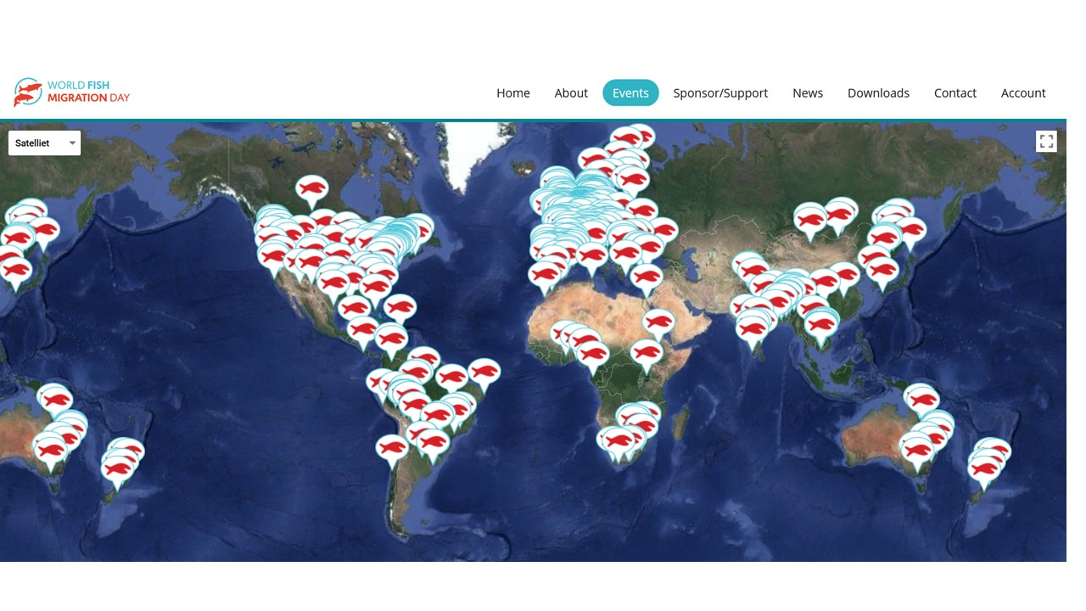

Slide 5
Flyways + Swimways + Pathways + Habitats
Climate Change
= ……. ?

Slide 6
