Slide 1
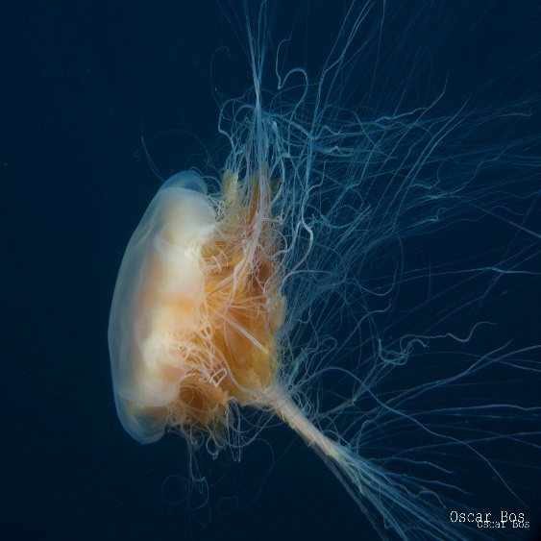
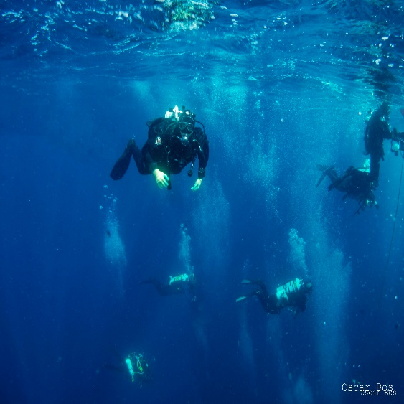
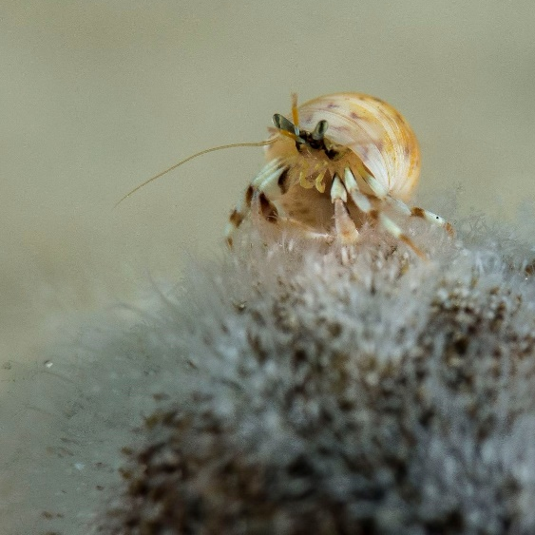
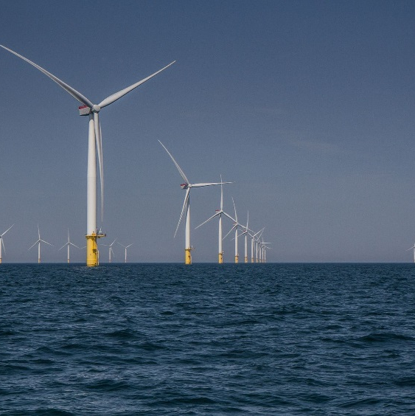
OSPAR en KRM indicatoren biodiversiteit Noordzee
Leeuwarden, 20 sept 2022, Oscar Bos

Slide 2
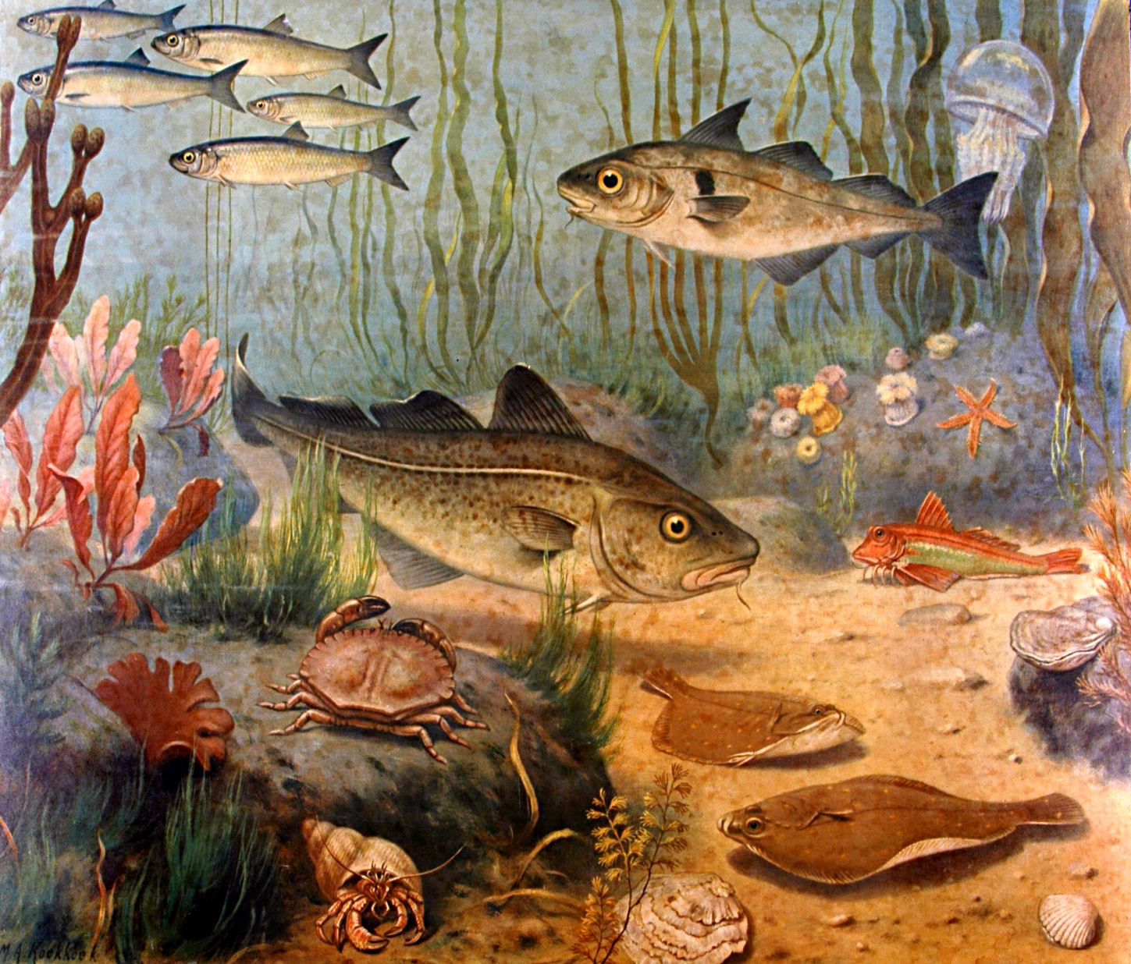
EU Kaderrichtlijn Mariene Strategie (2008)
Doel: goede milieutoestand (GES) van de EU zeeën in 2020 (cyclus van 6 jaar).
  De biodiversiteit wordt behouden
  Bodem integriteit

Slide 3
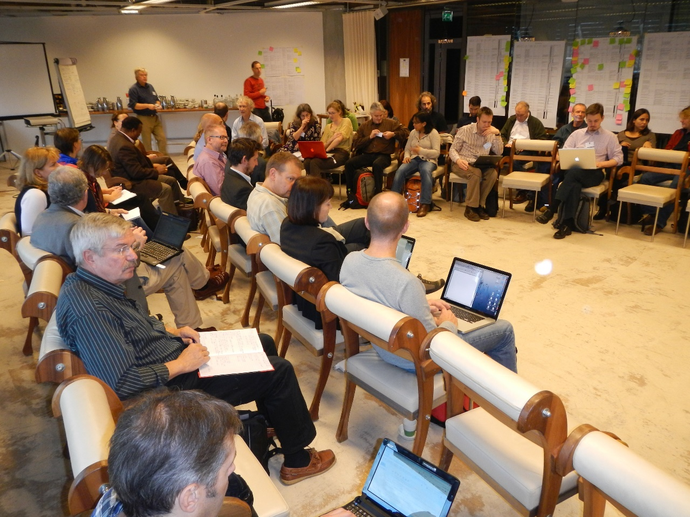
2011: Indicator workshop
>100 indicatoren
Large fish index
OSPAR
JNCC
OSPAR workshop in Amsterdam
Daarna verder in werkgroepen OSPAR (benthos, vissen, zeezoogdieren etc.)
Workshop report: https://www.ospar.org/documents?v=7306
Biogene riffen
Zeezoogdieren

Slide 4
Results
“Indicators can relate to state, impact, pressure and to operational measures; it is important to consider the relationship between GES and pressures from human activities. Currently, many indicators purely focus on state, rather than on pressures.”
“Indicators should:
  Reflect measurable aspects of state
  (or pressure, or activity)
  Link, if possible, to specific impacts or pressures
  Have threshold values that define desired quality
  Be common across regions or subregions “
DRIVER
Visserij
zandwinning
RESPONSE
Sanering, zonering, beschermde gebieden
IMPACT
Verlies soorten
STATE
Biodiversiteit
Omvang populatie
PRESSURE
bodemberoering

Slide 5
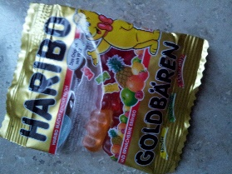
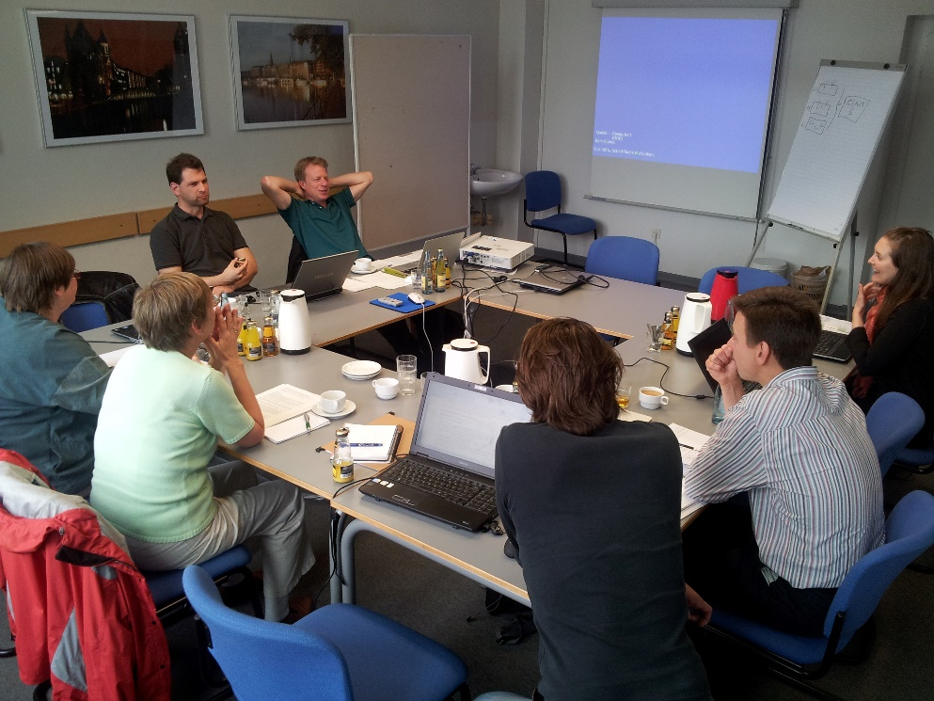
2012: OSPAR benthos werkgroep
OSPAR benthos working group Hamburg
Ontwikkeling benthos indicatoren
Workshop report: https://www.ospar.org/documents?v=7306

Slide 6
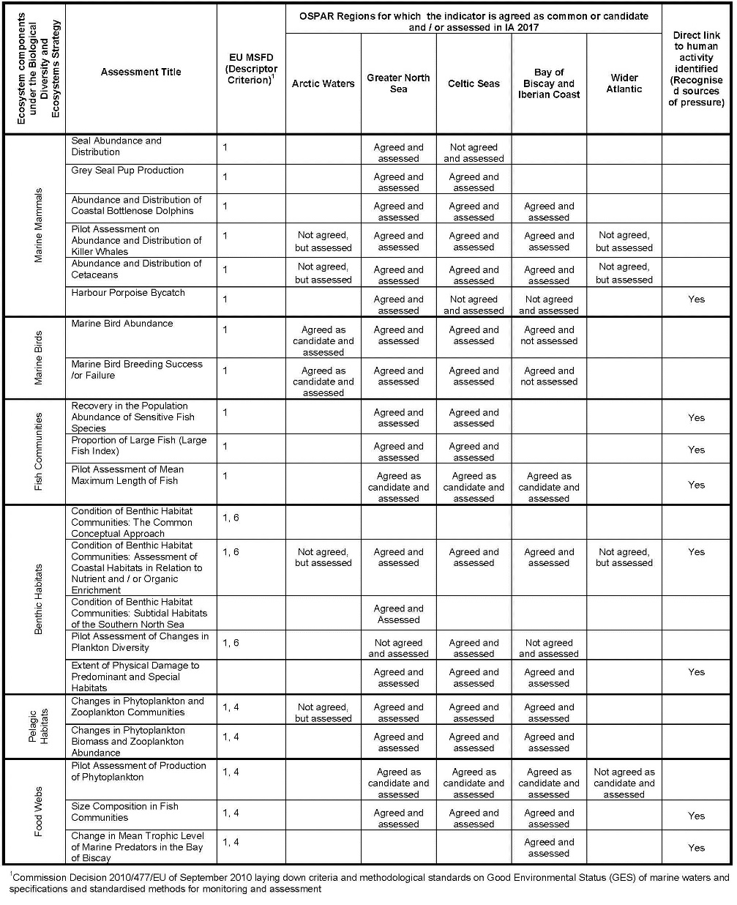
OSPAR 2017 assessement
Noordzee: 18 indicatoren biodiv
  16 common indicators
  2 candidate (test)
https://oap.ospar.org/en/ospar-assessments/intermediate-assessment-2017/introduction/what-assessed/

Slide 7
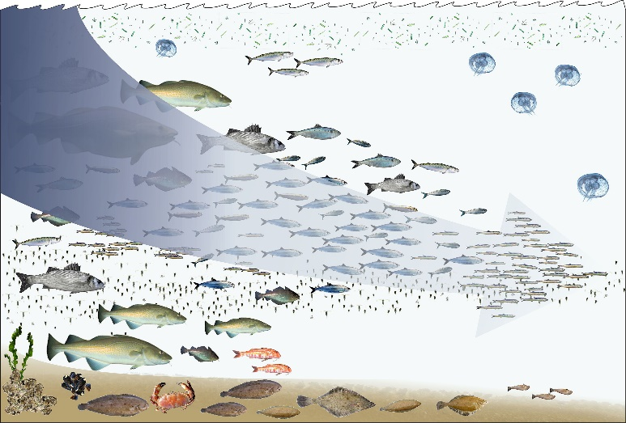
Large fish index
Visserij vist op grote vissen (bv > 30 cm)
Visserij beinvloedt daardoor structuur visgemeenschap
Reductie in visserij -> meer grote vissen
Large Fish Indicator: aandeel grote vissen
Data uit jaarlijkse bodemvissurveys Noordzee
By © Hans Hillewaert, CC BY-SA 4.0,
https://commons.wikimedia.org/w/index.php?curid=5805780
https://oap.ospar.org/en/ospar-assessments/intermediate-assessment-2017/biodiversity-status/fish-and-food-webs/proportion-large-fish-large-fish-index/

Slide 8
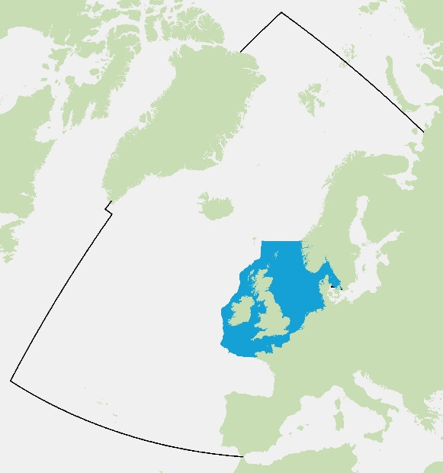
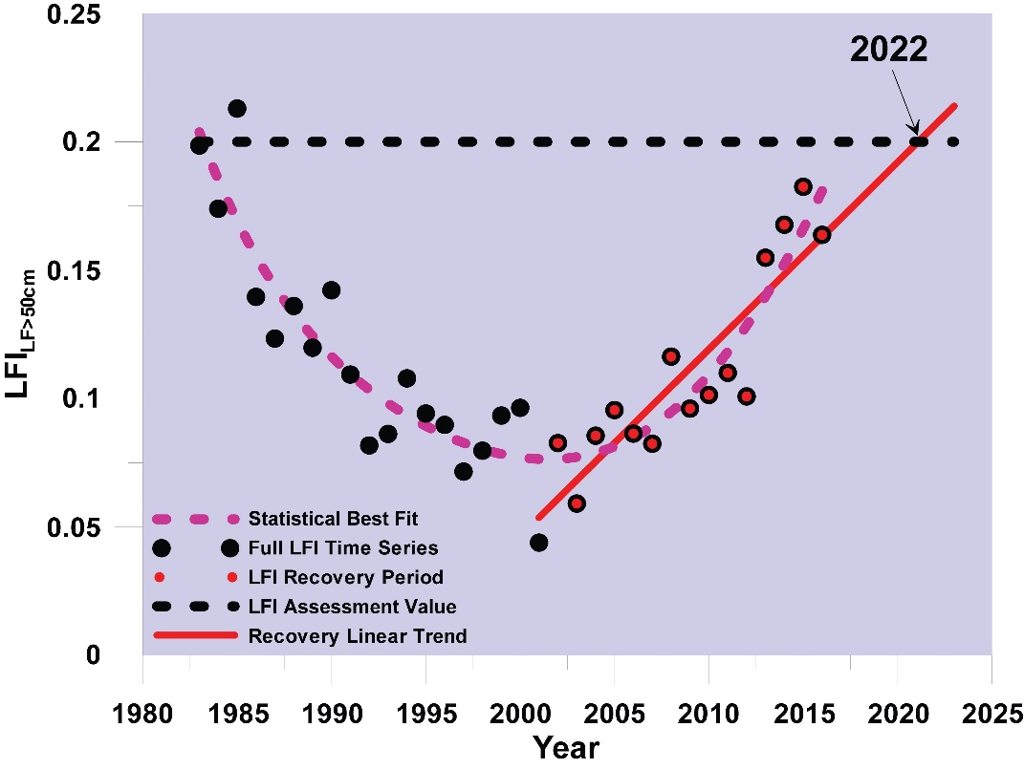

Large fish index (LFI)
https://oap.ospar.org/en/ospar-assessments/intermediate-assessment-2017/biodiversity-status/fish-and-food-webs/proportion-large-fish-large-fish-index/

Slide 9
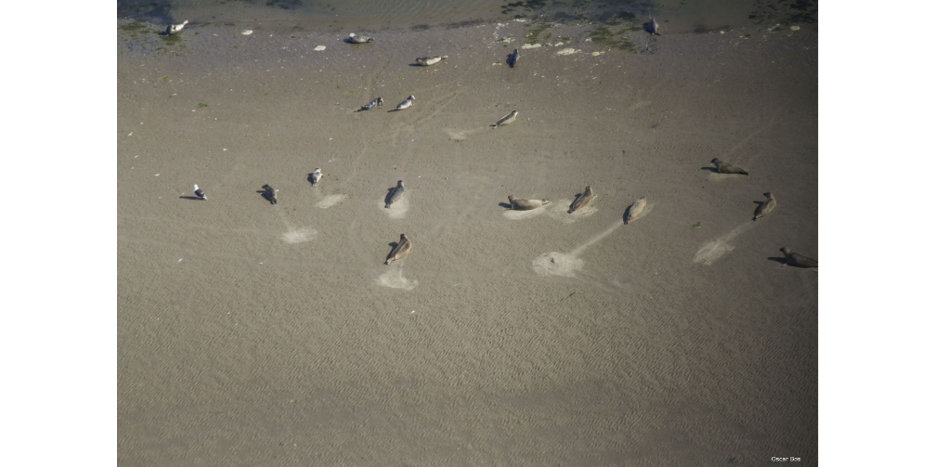
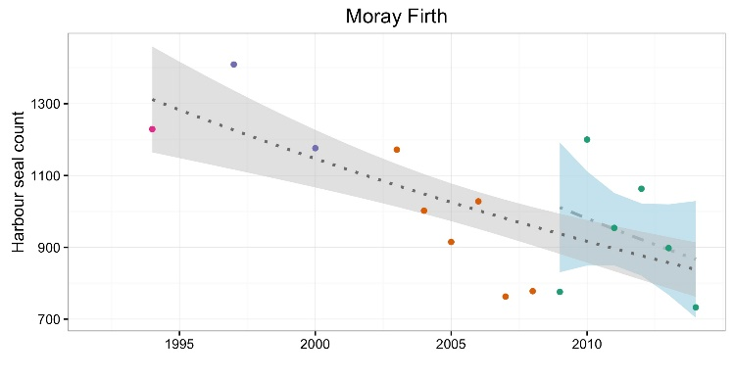
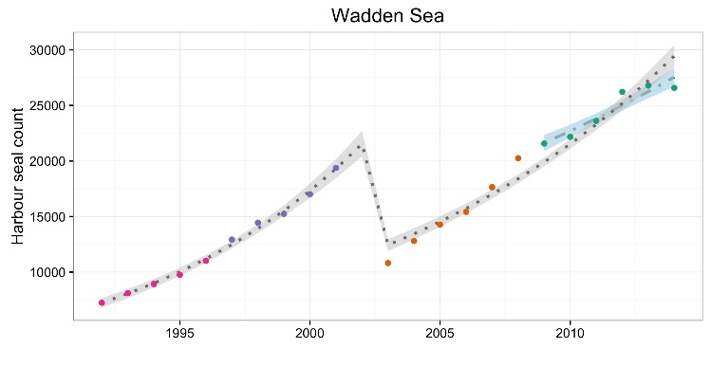
Zeehonden abundantie
Zeehonden zijn toppredatoren
Zijn populaties gezond?
Data: Tellingen
Grenswaarde: niet meer dan 10% afname populatie in 10 jaar
Virusziektes bedreiging
https://oap.ospar.org/en/ospar-assessments/intermediate-assessment-2017/biodiversity-status/marine-mammals/seal-abundance-and-distribution/

Slide 10
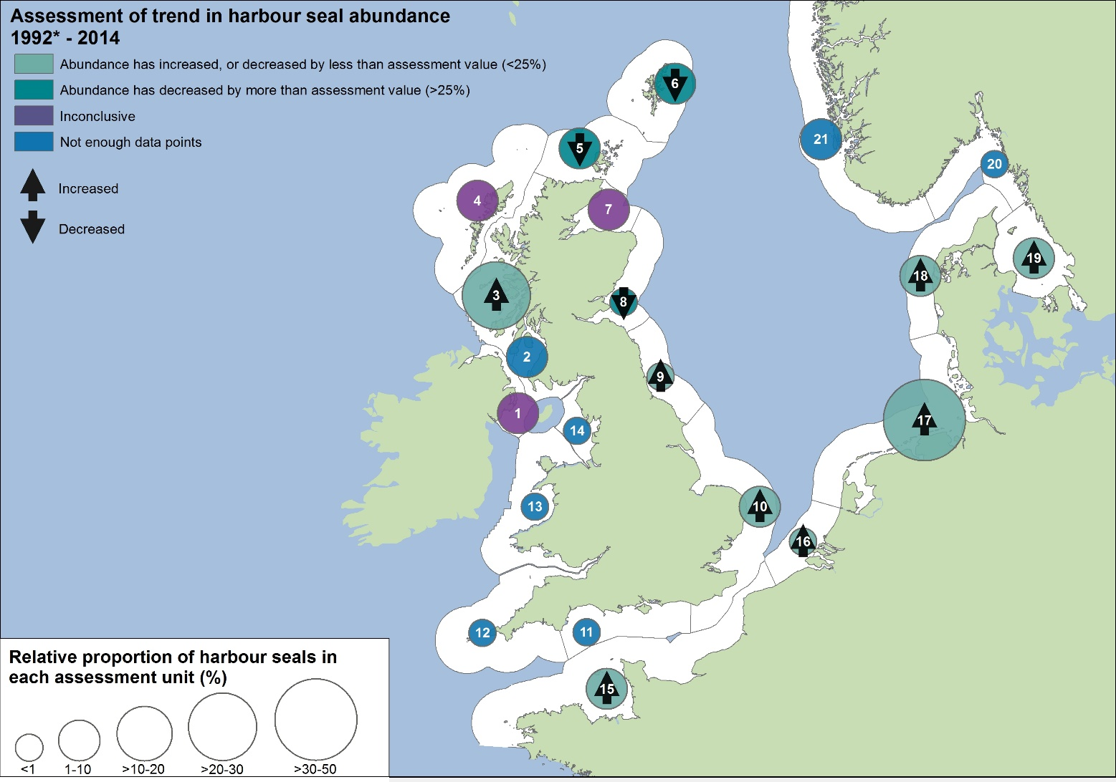

Marine mammal abundance indicator
https://oap.ospar.org/en/ospar-assessments/intermediate-assessment-2017/biodiversity-status/marine-mammals/seal-abundance-and-distribution/

Slide 11
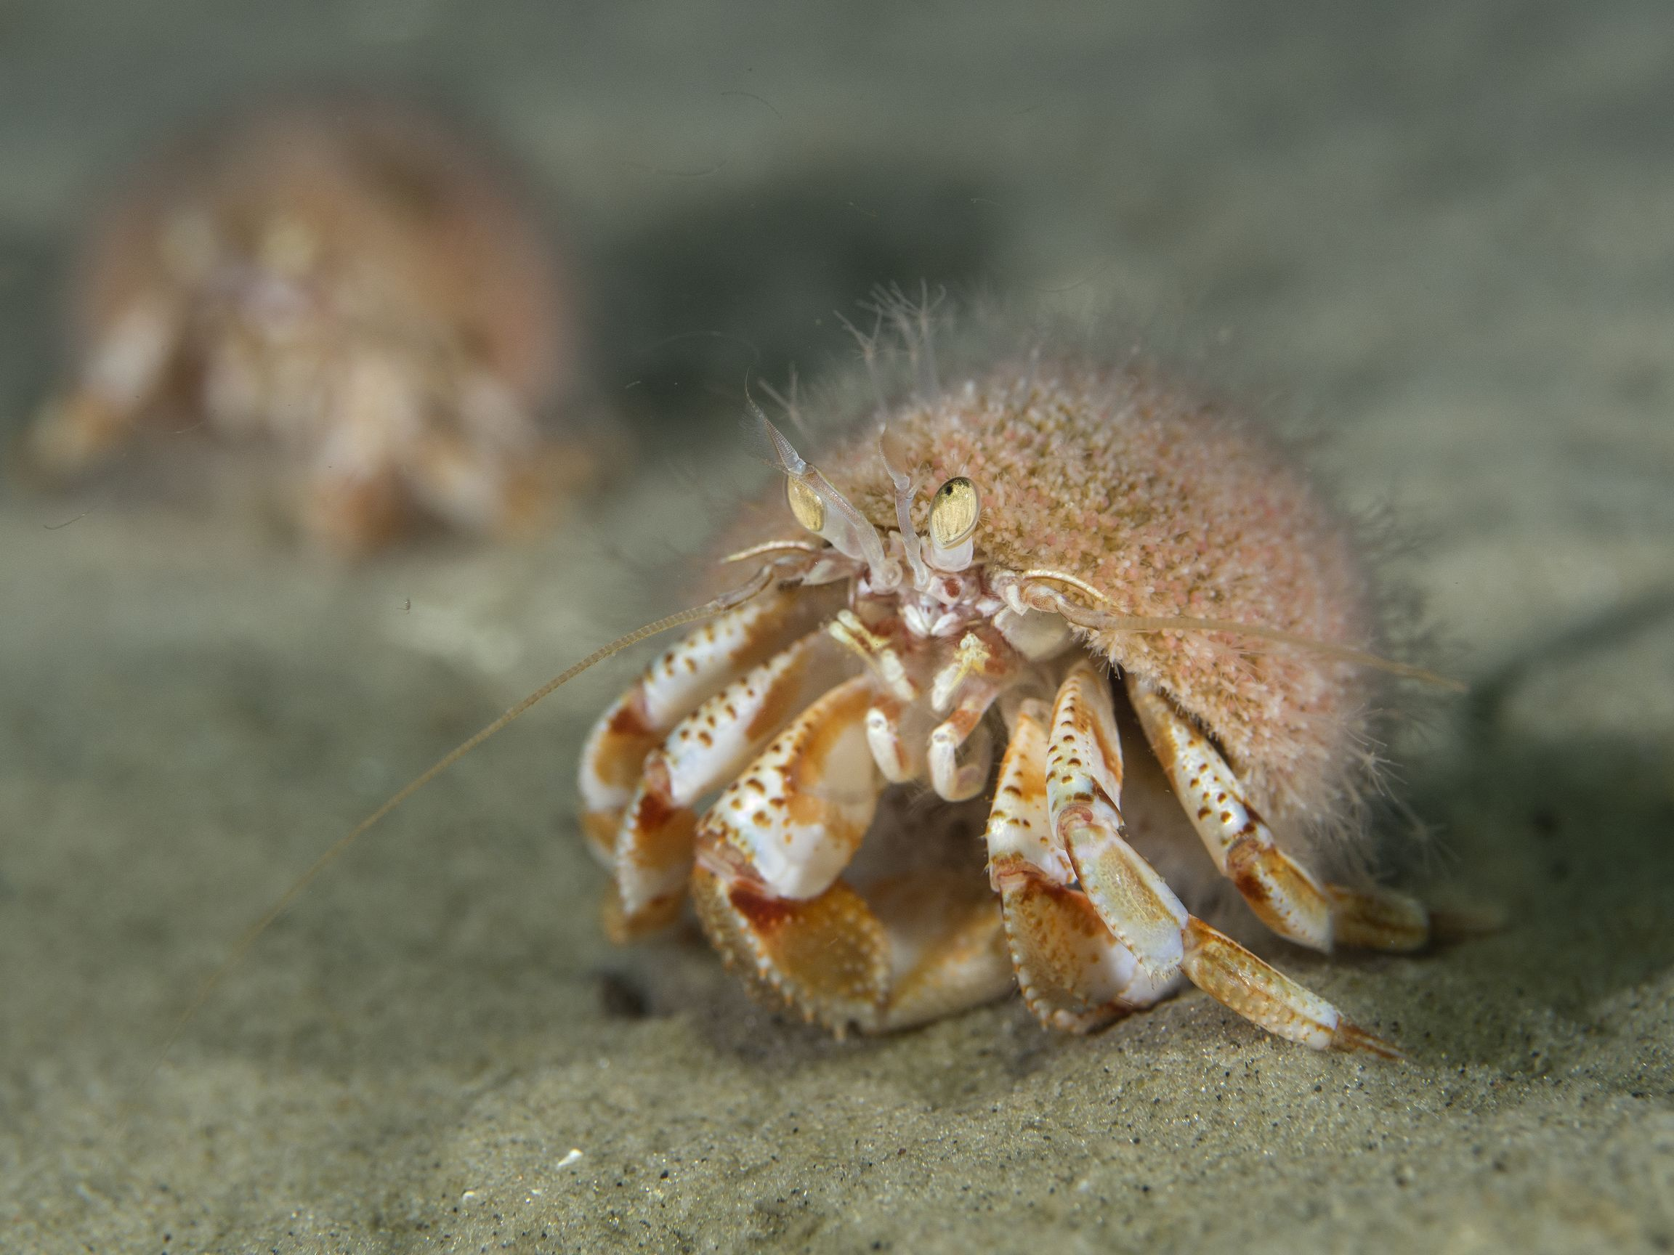

Slide 12
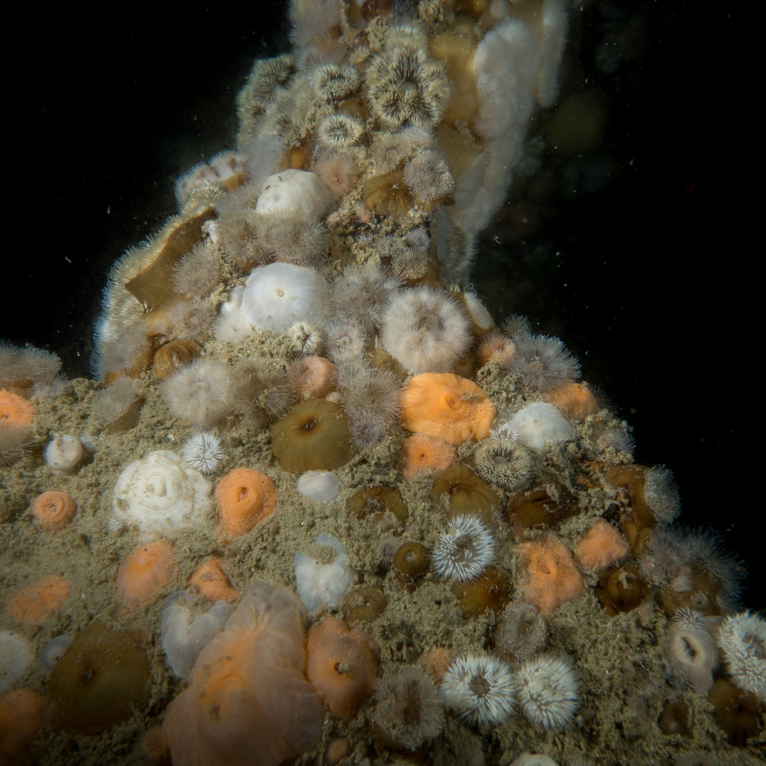
BISI indicator – NL (nog niet OSPAR)
Benthic Indicator Species Index (BISI)
Verschil biodiversiteit binnen/buiten gebieden
  Natura 2000 (art 17 HR rapportage)
  KRM gebieden
  bodembeschermingsgebieden

Slide 13
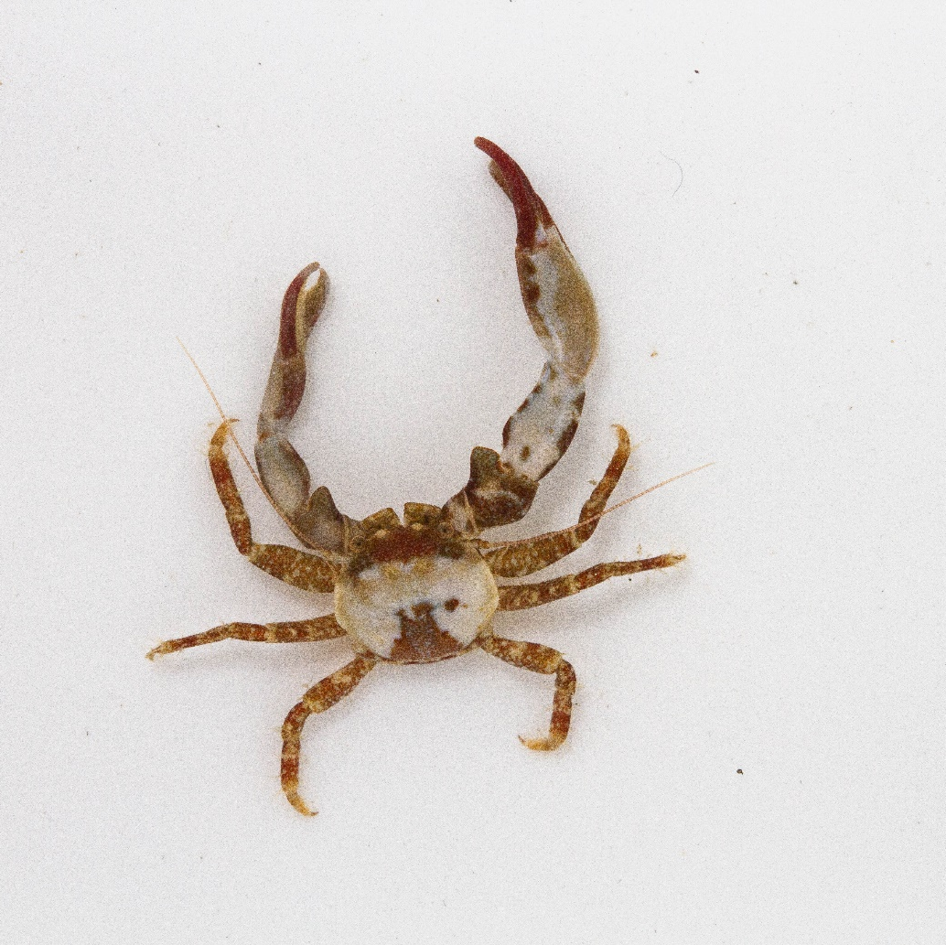
BISI
The occurrence (either densities, biomass or presence/absence data) of combinations of specific indicator species are compared with predefined reference levels (BISI internal reference) for those species representing a good quality status.

Slide 14

BISI slimme indicatorsoorten
http://ecoauthor.net/bisi/

Slide 15
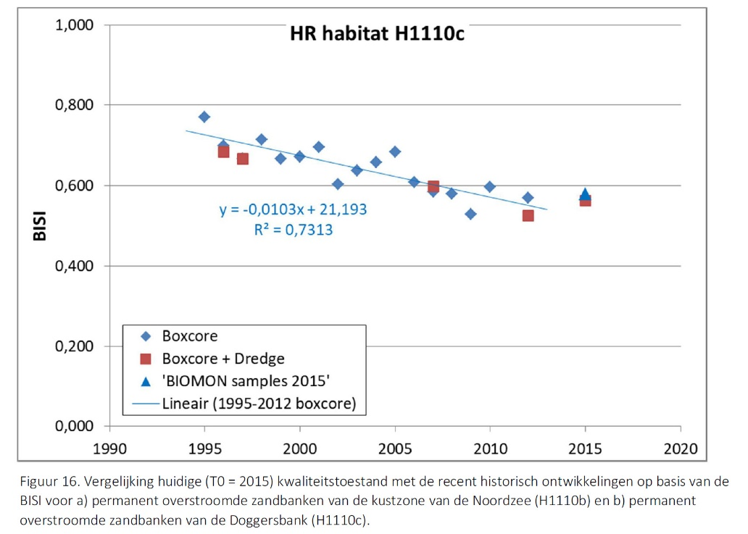
Benthos monitoring -> input BISI
Doggersbank (H1110c)

Slide 16

Dank!
Vragen?
Oscar.bos@wur.nl

